Slide 1
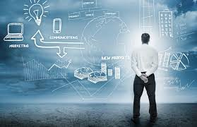
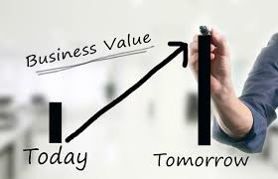
MIS782
Value of Information
Class 8: week 8

Slide 2
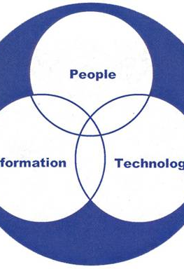
Assignment 2 Presentations
Any Questions?

Slide 3
MIS782: Value of information
HOW DO ICT INVESTMENTS GENERATE VALUE?
Firms need to understand: | How to gain competitive advantage based on the their underlying resources. | How competitive advantage from business and how emerging IT opportunities, such as social media analytics, can generate business value from investments in these areas. | Analyse how organisations adapt to changes or disruptors in the technology landscape to preserve and sustain an advantage.
In this unit, we will discuss: | Course One + Two | Course Three + Four | Course Five
 | Business Value Returns from IT Investments IT Portfolio Theory 3. Analysing competitive advantage - RBV 4. Analysing competitive advantage - VRIO | Analytics as a capability - I Business Case Development Analytics as a capability - II: From business data to business insight Emerging sources and SMA | 9. Dynamic capabilities through Information Asymmetries 10. Competing on Information Asymmetries

Slide 4
Week 8
VALUE OF INFORMATION
Phenomenon | Social Media Social Media Analytics
Abstraction | Social Media Analytics Benefit Framework Social Media Analytics Process
Application | Examples of different cases, Facebook in government NBA players’ tweet analysis

Slide 5


Accor hospitality
4100 properties in more than 90 countries
Increase customer satisfaction and quality of service
55% growth in positive feedback for Novotel brand
Significant decrease in the number of negative comments
Global social media monitoring and research company
Provided an online tool to track reputation of 12000 hotels by examining costumers’ opinions

Slide 6
What is Social Media?
Social media is
A “group of Internet-based applications that build on the ideological and technological foundations of Web 2.0, and that allow the creation and exchange of user generated content”.
Kaplan and Haenlein (2010)
Web 2.0 is
Web 2.0 allows for user interaction and participation by having a user-friendly interface where one can edit and publish the existing information. It utilises social networking tools to further increase the level of viewer participation.
Notes:
Social media enables users to generate content by sharing their knowledge, opinions and experiences on a variety of issues.
Social media has changed the way customers engage with organizations, brands, products and services.
It influences customer attitudes, perceptions and buying decisions.
Social media provides organizations with many opportunities. It provides a new and powerful low cost marketing channel that can be harnessed to increase customer awareness of organizations and associated brands, products and services.
Also, it enables organizations to improve their customer relationships through better engagement on a real time basis.

Slide 7
My Definition of Social Media
Sharing, connecting, Collaborating, co-creating value
Two-way communication
Ubiquity, flexibility, life-long learning
Users generated content
Rethink service delivery
Gartner Hype Cycle

Slide 8
Social Media Analytics (SMA)
Social media analytics (SMA)
“is concerned with developing and evaluating informatics tools and frameworks to collect, monitor, analyse, summarize, and visualize social media data … to facilitate conversations and interactions … to extract useful patterns and intelligence…”
Fan and Gordon (2014)
“SMA uses advanced techniques to analyse patterns in social media data to enable informed and insightful decision-making.”
Bekmamedova and Shanks (2014)
“the use of analytics capabilities to analyse and interpret vast amounts of semi-structured and unstructured social media data.”
Chen et al. (2012)
Notes:
SMA uses the content of social media platforms (e.g. Twitter, Facebook) to create a real-time understanding of how people, trends, products and brands are mentioned in those social media sites.
SMA provides organizations with an ‘intimate’ platform to connect with customers and shape their perceptions, whether through timely and targeted campaigns, responsive customer service or creating communities of interest.
It enables organizations to track and understand customer views, sentiments, key topics and trends and identify key influencers.
SMA provides a new strategic approach towards business decision-making resulting in new ways to create value.
The business question addressed in this session is: How do organizations achieve value with social media analytics?
To address this question, we focus on two key issues: understanding the motivations that explain why organizations use SMA; and understanding how the use of SMA leads to organizational value?
In this session, we describe a framework based on awareness motivation and the resource-based view (RBV), in which SMA resource combinations are required to successfully implement SMA initiatives.

Slide 9
Distinguishing the fields of SMA, Big Data, and Business Analytics
BIG DATA
SMA
Big Data involves the data storage, management, analysis, and visualization of very large and complex data sets (Remember: 3Vs!!!) |  | SMA uses this data, but it focuses primarily on the interpretation and use of insights from social media data to achieve organizational benefits.
Business Analytics
SMA
BA involves the analysis and interpretation of structured, historical organizational data, to gain insights and achieve organizational benefits. |  | SMA uses different techniques to analyse and interpret unstructured, text-based social media data to gain insight into contemporary, rather than historical, phenomena.
Notes:
Although SMA is closely related to big data and BA, there are some key differences between these concepts.
SMA can be distinguished big data and BA as follows.
Big data focuses on new data management techniques that supersede traditional relational systems, and are better suited to the management of large volumes of social media data.
We argue that these differences are important and while there is some overlap between SMA, big data and BA, the differences are very important in terms of motivations, resources required and benefits achieved.

Slide 10

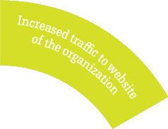



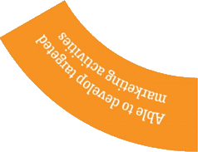
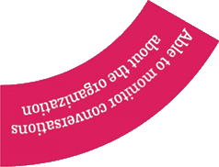
The need for SMA
Businesses may use Social Media Analytics to:
Capture consumer data
Predict customer behaviour and improve customer satisfaction
Create customized campaigns and promotions
Identify the primary influencers within specific social network channels and target them with unique offers
Notes:
Businesses may use Social Media Analytics to:
Capture consumer data from social media to understand attitudes, opinions and trends, and manage your online reputation
Predict customer behaviour and improve customer satisfaction by anticipating customer needs and recommending next best actions
Create customized campaigns and promotions that resonate with social media participants
Identify the primary influencers within specific social network channels and target them with unique offers

Slide 11


Social Media Analytics and Business Value - Example
Nike China "Find Your Greatness"
“L'Oréal” 1:1 marketing through SMA
Personalisation strategy
Notes:
L’Oréal helps millions of customers feel beautiful every day. L'oreal Australia is using Marketing Cloud Journey Builder to build ​personal ​customer journeys across it's 28 brands. L'​O​real is betting on Salesforce Marketing Cloud and Sales Cloud to reach a new generation of savvy, multi-brand shoppers​ in new ways, mapping out customer journeys across mobile apps, email and social media.
Watch Rodrigo Pizzarro, Managing Director Australia and New Zealand and Christophe Eymery, ​H​ead of Digital​,​ Australia and New Zealand discuss the power of SMA for (one-on-one communication).
We focus on social media activities at the level of management and organization. This includes how firms manage and allocate their internal resources when adopting and using SMA to meet business objectives in order to create value.

Slide 12
SMA Benefits Framework
This framework includes how firms manage and allocate their internal resources when adopting and using SMA to meet business objectives in order to create value.
SMA Resources
Awareness Motivation
Leads to
IT assets and SMA capabilities
Dynamic Capabilities
Leads to
Awareness Benefits
Bekmamedova and Shanks (2014)
Notes:
Much is known about the benefits that can be achieved with BA, including increased customer profitability, reduced customer attrition, and increased response rates from marketing campaigns. However, there is no systematic explanation as to how and why SMA brings value and competitive advantage to organizations.
The SMA framework comprises three main concepts: awareness motivation, SMA resources and awareness benefits.
Motivations are the goals that an organization pursues and guide the subsequent actions of that organization. Typical motivations include better customer engagement, increased brand awareness, and greater market value.
SMA resources include effective combinations of IT assets and SMA capabilities that take time to develop, and require significant of learning and optimization. They also include dynamic capabilities that enable organizations to respond to environment turbulence by renewing and reconfiguring its existing resource base.
Awareness benefits reflect the extent to which SMA resources contribute to the success of the organization. Benefits may be measured using financial, perceptual and behavioural indicators.

Slide 13
Relationships in the SMA Benefits Framework
SMA Resources
Awareness Motivation
Leads to
IT assets and SMA capabilities
Dynamic Capabilities
Leads to
Awareness Benefits
SMA Resources
Sentiment Analysis resources and capabilities
Motivation
Developing insights into customers
Benefits
Customer Engagement, Brand Awareness
Notes:
There are two relationships in the SMA value framework: Awareness motivation leads to SMA Resources, and SMA resources lead to awareness benefits.
Awareness motivation defines the goals that an organization pursues, that guide the subsequent actions of that organization. Depending on the particular awareness motivation, an organization will develop, outsource, acquire and renew its SMA resources in order to achieve those goals. We defined three awareness motivations: (1) developing insights into customer’s values and behaviours; (2) understanding the impact and effectiveness of online marketing campaigns; and, (3) discovering new ideas for brand reputation and engagement purposes. Each of these different motivations will lead to particular SMA resources.
For example, the insights into customer values and behaviours motivation should lead to the development, outsourcing, acquisition and renewal of IT assets and SMA capabilities related to sentiment analysis.
SMA resources are the IT assets, SMA capabilities and dynamic capabilities relevant to a particular awareness motivation. Based on RBV, we argue that SMA resources lead to awareness benefits. For example, a sentiment analysis SMA resource should lead to better customer engagement and brand awareness as sources of awareness benefits.

Slide 14
RBV and Dynamic Capabilities: A brief recap
RBV help understand how investments in IS lead to organizational value and competitive advantage.
An organization may be viewed as a collection of resources and capabilities that enable it to succeed and compete. Resources comprise both assets and capabilities.
To be of strategic importance and achieve competitive advantage, resources must be valuable, rare, inimitable and non-substitutable (VRIN).
Hardware
Competencies (skills)
Resources/Assets
Software
Capabilities
Practices (routines)
Data
Notes:
The RBV has been widely used by information systems (IS) researchers in relation to understanding how investments in IS lead to organizational value and competitive advantage. An organization may be viewed as a collection of resources that enable it to succeed and compete. Resources comprise both assets and capabilities. Assets include hardware, software and data. Capabilities include competencies (skills) and practices (routines). To be of strategic importance and achieve competitive advantage, resources must be valuable, rare, inimitable and non-substitutable (VRIN).
Dynamic capabilities extend the RBV by ‘shaping’ and reconfiguring an organization’s existing resources to adapt to rapidly changing technology and business environments

Slide 15
a) Awareness Motivation
Awareness Motivation is defined as collecting and analysing social media data in order to increase organizational knowledge or understanding about issues related to customer-empowered environments.
In SMA, there are three main goals for awareness motivation:
Developing insights into customer’s values and behaviour
Understanding the impact and effectiveness of online marketing campaigns.
Discovering new ideas for brand reputation and engagement purposes.
Notes:
Organization motivations are defined as the goals that an organization pursues, that guide the subsequent actions of that organization.

Slide 16
b) SMA Resources
SMA resources are mutually reinforcing systems of:
IT assets (IT infrastructure and SMA tools),
SMA capabilities (analytical competencies and practices)
Dynamic capabilities.
Notes:
Awareness motivations drive organizations to develop and renew SMA resources in order to understand the content, context and business impact of online posts and conversations (sentiment analysis), discovering valuable customer information (insight mining), and monitoring relationships between online users and communities (influence analysis, network analysis).

Slide 17
1) IT Assets
IT assets are combinations of IT hardware, software and networks that provide the foundation for shared IT services.
Storage and analysis technologies for large-scale unstructured databases (e.g. Hadoop)
SMA applications (e.g., SPSS predictive analytics, and Google Analytics)
External social media data streams as opposed to traditional information assets stored in internal databases.
Notes:
Whereas traditional information assets involve an organization’s internal databases and information shared with business partners, SMA requires new data assets. Organizations require access to external social media data streams to identify trends and important issues quickly to drive business change. These new IT assets include storage and analysis technologies for large-scale unstructured databases (e.g. Hadoop). Eventually, this will facilitate the development of a big data capability for firms.

Slide 18
2) SMA Capabilities
SMA capabilities are Interlocking systems of competences and practices that enable organizations to utilize SMA applications to perform SMA tasks.
SMA competencies refer to the skills embodied in individuals or teams that actively manage or accomplish organizational tasks. They have two dimensions:
Skills related to IT, SMA, and Business understanding
Skills related to management
SMA practices serve as a means of accomplishing organizational tasks and as mechanisms for storing and accessing knowledge about the most effective ways to accomplish those tasks.
Notes:
For example, in order to perform a customer insight-mining task, an organization needs to allocate appropriate IT assets and people with relevant SMA competencies. To interpret and insights gained from that data and take actions, organizations need to embed them into daily business routines. Two key aspects of SMA capabilities within organizations are competencies (skills) and practices (routines).
“IT, SMA and business understanding skills” relate to application development, database administration, and networking complemented by business skills.
The “SMA skills” include management of unstructured data, text mining, natural language processing, machine learning, and social network analysis. SMA skills are prominent in the recently emerging role of data scientist.
“Management skills” include a strong commitment to SMA initiatives and alignment of SMA initiatives with other business initiatives.
“Practices and competencies” support and complement each other. Practices help individuals and teams develop competencies with particular ways of working, while competencies are necessary for the effective execution of organizational practices toward specified goals.
Successful use of SMA insights depends on three key organizational practices: customer management, process management and performance management.
“Customer management” is an organization’s ability to understand its customer base (e.g. expectations) and market characteristics. This is important in an SMA context, as it enables organizations to improve their customer and market intelligence.
“Process management” is an organization’s ability to attain flexibility, speed, and cost economies through the effective design and management of key processes. In an SMA context, process management practices ensure that SMA insights are integrated with relevant business process and appropriate metrics and controls are developed.
“Performance management” is an organization’s ability to design and manage effective performance measurement and monitoring systems to support managerial decision-making and communication of performance to appropriate stakeholders. If a SMA insight is exercised effectively, the organization will be able to measure its business impact and execute relevant competitive actions.

Slide 19
3) Dynamic Capabilities
The role of Dynamic Capabilities is to renew and reconfigure other assets and capabilities, to ensure they remain valuable, rare, inimitable and non-substitutable (VRIN).
Dynamic capabilities involve two routines:
Searching for and selecting new innovations and opportunities, and asset orchestration to renew and reconfigure assets and capabilities
Notes:
The ability of IT assets and SMA capabilities to provide organizational benefits may change over time in turbulent environments. The RBV has been criticized as being too ‘static’ in nature, and dynamic capabilities have been proposed as a means of renewing and reconfiguring IT assets and SMA capabilities to ensure they continue to provide benefits and competitive advantage.
Dynamic capabilities are conceptualized as ‘second order’ constructs, as they are not directly involved in the production of goods or provision of services. Their role is to renew and reconfigure other ‘first order’ assets and capabilities, to ensure they remain valuable, rare, inimitable and non-substitutable (VRIN).
In the context of SMA resources, search and select routines involve identifying opportunities to exploit SMA in order to provide increased organizational benefits.
Asset orchestration involves implementing the selected SMA opportunity by identifying required IT assets and SMA capabilities and sourcing them.

Slide 20
c) Awareness Benefits
Three types of awareness benefits can be achieved with SMA:
Customer-related benefits
Financial-related benefits
Organisational effectiveness
Notes:
Better understanding of customer satisfaction levels, improved customer engagement and better knowledge of customer sentiments about products and services.
Financial-related benefits are often indirectly related to customer-related and organizational effectiveness-related benefits and may take some time to occur.
Higher levels of innovation, and improved production and supply chain flexibility and improved marketing campaign success.

Slide 21
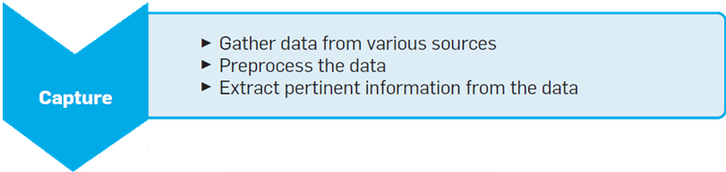

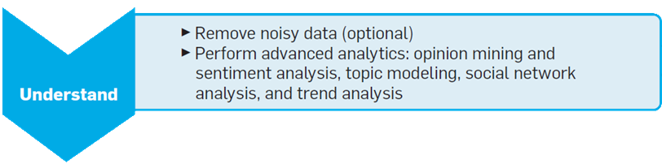
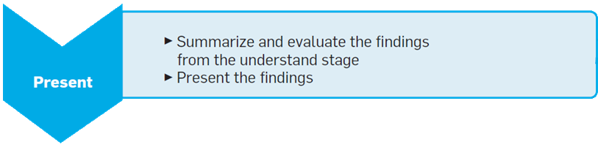
The Process of SMA
Notes:
Social media analytics involves a three-stage process: “capture,” “understand,” and “present” (see Figure 1), the CUP framework. Capture involves obtaining relevant social media data by monitoring, or “listening,” to various social-media sources, archiving relevant data and extracting pertinent information. It can be done by a company itself or through a third-party vendor. Not all captured data is useful, however. Understand selects relevant data for modeling while removing noisy low-quality data, using various advanced data analytic methods on the data and gain insight from them. And present deals with displaying findings from the understand state in a meaningful way.
There is also some overlap among the stages; for instance, the understand stage creates models that can help in the capture stage. Likewise, visual analytics supports human judgments that complement the understand stage, as well as assist in the present stage. The stages are conducted in an ongoing, iterative manner rather than strictly linearly. If the models in the understand stage fail to reveal useful patterns, they may be improved by capturing additional data to increase their predictive power. Likewise, if presented results are not interesting or lack predictive power, it may be necessary to return to the understand or capture stages to adjust the data or tune the parameters used in the analytics. A system supporting social media analytics may go through several iterations before being truly useful.

Slide 22
a) Capture
The capture stage helps identify conversations on social media platforms related to its activities and interests.
The capture phase covers popular platforms, as well as smaller, more specialized sources.
Various pre-processing steps may be performed, to prepare a dataset for the understand stage.
The capture stage must balance the need to find information from all quarters (inclusivity) with a focus on sources that are most relevant and authoritative (exclusivity) to assist in more refined understanding.
Notes:
(such as Facebook, Twitter, and YouTube)
(such as Internet forums, blogs, microblogs, wikis, news sites, picture-sharing sites, podcasts, and social-bookmarking sites)
Including data modelling, data and record linking from different sources, stemming, part-of-speech tagging, feature extraction, and other syntactic and semantic operations that support analysis.
Information about businesses, users, and events, as well as user comments and feedback and other information, is also extracted for later analytical modelling and analysis.

Slide 23
b) Understand
b) Understand
The understand stage helps assess the meaning of the collected conversations and then generate metrics useful for decision making.
Assessing meaning from the cleaned data can involve statistical methods and other techniques derived from text and data mining, natural language processing, machine translation, and network analysis.
Note: The understand stage is the core of the entire social media analytics process.
Notes:
When a business collects the conversations related to its products and operations, it must then assess their meaning and generate metrics useful for decision making — the understand stage.
Since the capture stage gathers data from many users and sources, a sizeable portion may be noisy and thus have to be removed prior to meaningful analysis.
The understand stage provides information about user sentiment— how customers feel about a business and its products—and their behaviour, including the likelihood of, say, purchasing in response to an ad campaign. Many useful metrics and trends about users can be produced in this stage, covering their backgrounds, interests, concerns, and networks of relationships.
Its results will have a significant effect on the information and metrics in the present stage, thus the success of future decisions or actions a business might take.

Slide 24
c) Present
In the present stage, the results from different analytics are summarized, evaluated, and shown to users in an easy-to-understand format.
Visualization techniques (Dashboards) may be used to present useful information.
Notes:
One commonly used interface design is the visual dashboard, which aggregates and displays information from multiple sources.

Slide 25
SMA Techniques
Sentiment Analysis
Topic Modelling
Social Network Analysis
Trend Analysis
Visual Analytics
Some techniques support several stages of social media analytics:
Topic Modelling and Social Network Analysis → Understand
→ Capture and Present
Notes:
Social media analytics encompasses a variety of modelling and analytical techniques from different fields. Here, we highlight the most instrumental in understanding, analysing, and presenting large amounts of social media data.
Some techniques support several stages of social media analytics: Sentiment analysis and trend analysis primarily support the understand stage; topic modelling and social network analysis have primarily application in the understand stage but can support the capture and present stages as well; and visual analytics spans the understand and the present stages.

Slide 26
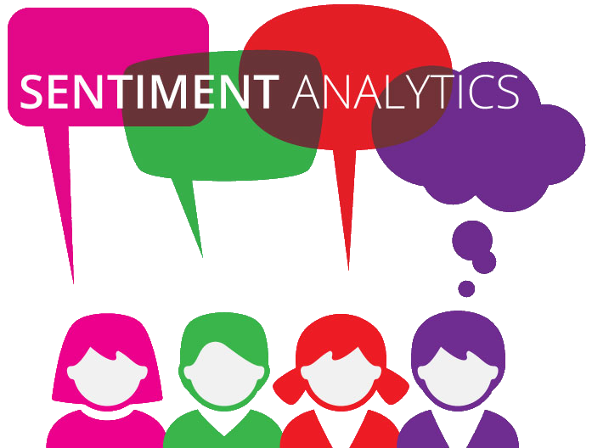
Sentiment Analysis
Sentiment analysis (opinion mining) leverages computational linguistics, natural language processing, and other methods of text analytics to automatically extract user sentiment or opinions from text sources at any level of granularity.
Fan and Gordon (2014)
Sentiment analysis methods include:
Word counts
Polarity lexicons
Semantic methods
Notes:
Opinion mining, or sentiment analysis, is the core technique behind many social media monitoring systems and trend-analysis applications
The process of computationally identifying and categorizing opinions expressed in a piece of text, especially in order to determine whether the writer's attitude towards a particular topic, product, etc. is positive, negative, or neutral.
Such subjective information extracted about people, products, and services supports predicting the movement of stock markets, identifying market trends, analysing product defects, and managing crises.
“Word counts” (the more a product is mentioned, the more it is assumed to be liked).
“polarity lexicons” or lists of positive and negative terms that can be counted when used, as in, say, text messages that mention a product by name.
“Semantic methods” that may compute lexical “distances” between a product’s name and each of two opposing terms (such as “poor” and “excellent”) to determine sentiment.

Slide 27
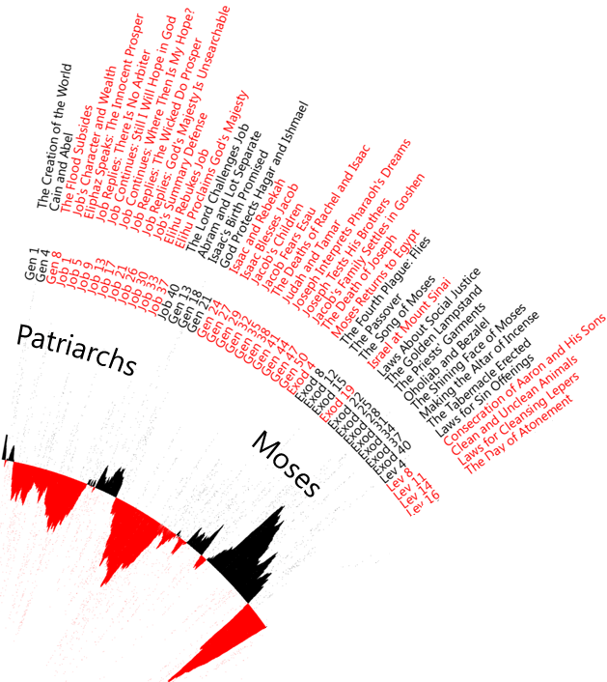
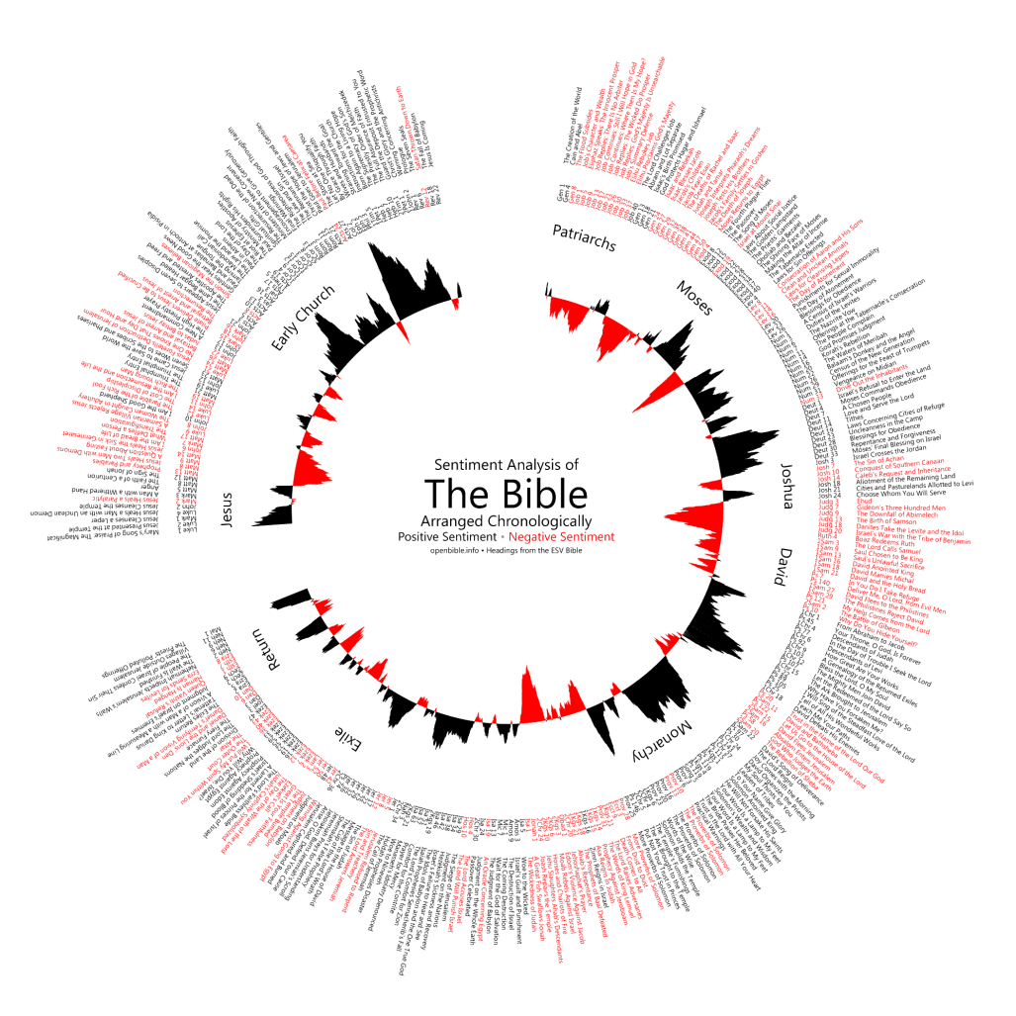
Sentiment Analysis: Example
Notes:
POLARITY LEXICONS
This visualization explores the ups and downs of the Bible narrative, using sentiment analysis to quantify when positive and negative events are happening:
Things start off well with creation, turn negative with Job and the patriarchs, improve again with Moses, dip with the period of the judges.
In the New Testament, things start off fine with Jesus, then quickly turn negative as opposition to his message grows.

Slide 28

capturing
From (https://www.yahoo.com/style/horoscope/scorpio/daily-20160420.html)
DAILY
“It's to your advantage to reconsider a budget that you thought would carry you comfortably through the rest of the year. Your traditional planetary ruler Mars is retrograde in your 2nd House of Money for the next couple of months, bringing up financial concerns. However, some of your worries might be based upon an irrational fear of not having enough, rather than on the actual bottom line. Never let the things you want make you forget the things you have. Prosperity is a state of mind.”
Notes:
http://www.informationisbeautiful.net/2011/horoscoped/
Do horoscopes really all just say the same thing? We scraped & analysed 22,000 to see.
How do you gather 22,000 horoscopes? Obviously you could manually cut and paste them from one of the many online Zodiac pages. But that, we calculated, would take about a week of solid work (84.44 hours).

Slide 29
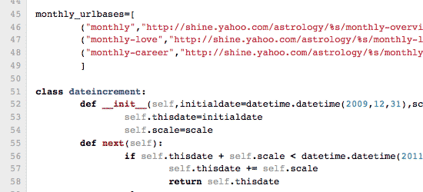
capturing
A Python script was used to screen-scrape 22,186 horoscopes into a single massive spreadsheet.
Notes:
So they wrote a Python script to screen-scrape 22,186 horoscopes into a single massive spreadsheet. Screen-scraping is pulling the text off a website after it’s displayed. Python is a programming language. You can use it to write scripts that only gather the specific text you want. Then you run it multiple times so it mines an entire website.
Well, it’s not quite that easy. Big sites like Yahoo have ‘rate-limiting’ on their servers. That means if you access a page too many times too quickly, it thinks you’re a hacker and deploys all kinds of anti-hacking counter-measures. Initially, Thomas set his scraping speed too high (once every 10th of a second) and his IP got instantly banned from Yahoo for 24 hours. After some experimenting (and more bans), he found that a two second delay between scrapes prevented the defense mechanisms from kicking in. The script was set to run in the background (while we smoked cigars and discussed the empire). 12 hours later, we had our 22,000 horoscopes in a single file!

Slide 30
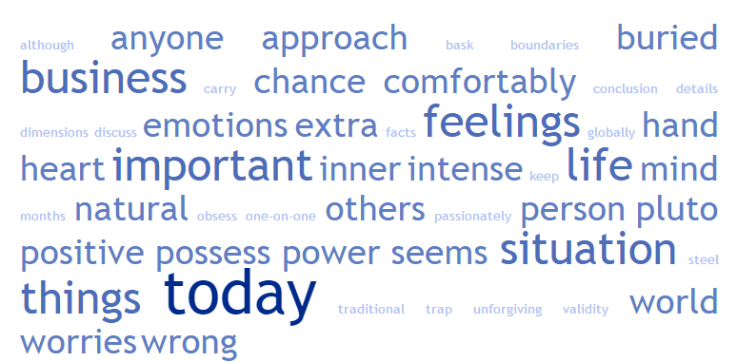
understanding
‘TagCrowd’ was used to find the most frequently appeared words in each horoscope.
Notes:
They used an online tool called “TagCrowd” to find the most common words.
So they broke down the most common 50 words to see if there are any patterns of unique words. This is what was revealed:

Slide 31
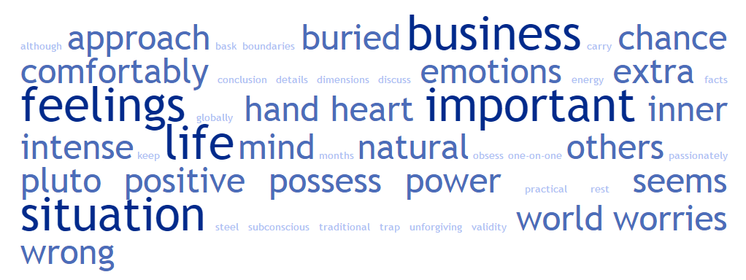
understanding
Qualifiers such as ‘someone’, ‘really’, ‘quite’ were stripped out and they redone the analysis.
Notes:
It struck me that several words in the top 50 – like “someone”, “really”, “quite” – were just qualifiers and not really that revealing. You’d find them in any English word analysis.
Qualifiers and intensifiers are words or phrases that are added to another word to modify its meaning, either by limiting it (He was somewhat busy) or by enhancing it (The dog was very cute).
So we stripped those kinds of words out (see our stoplist). And lo! A fresh set of unique, revealing and more accurate words appeared in the top words per sign.

Slide 32
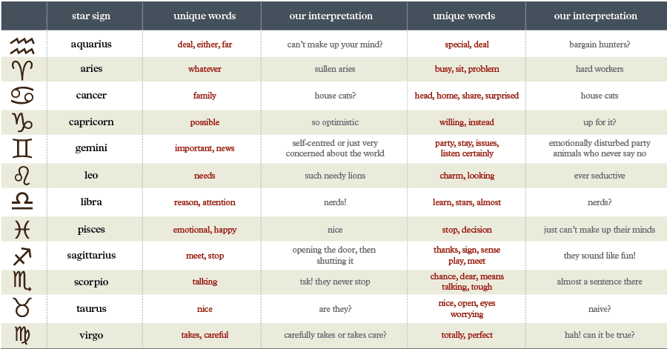
understanding
Common words loosely filtered
Common words tightly filtered
Notes:
This was the data we used to create our meta-chart.

Slide 33
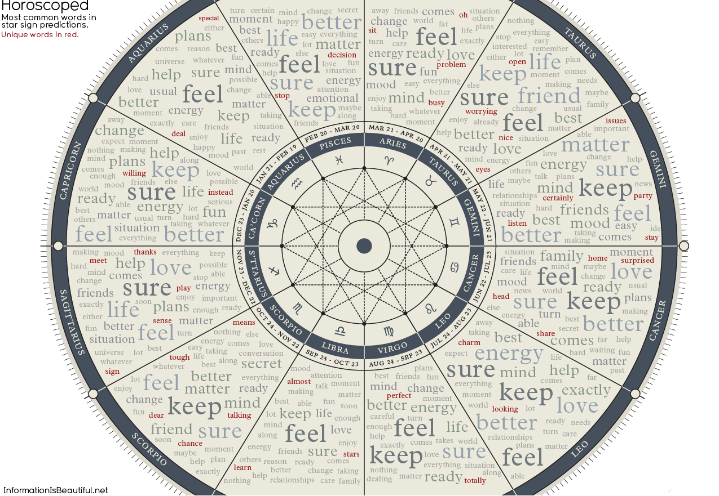
Visualising
Notes:
http://www.informationisbeautiful.net/2011/horoscoped/
Do horoscopes really all just say the same thing? We scraped & analysed 22,000 to see.
How do you gather 22,000 horoscopes? Obviously you could manually cut and paste them from one of the many online Zodiac pages. But that, we calculated, would take about a week of solid work (84.44 hours).

Slide 34
Topic Modelling
Topic modelling is used to sift through large bodies of captured text to detect dominant themes or topics.
Themes can be used to provide consistent labels to explore the text collection or to feed other analytical tasks (such as discovering user interests).
Notes:
In machine learning and natural language processing, a topic model is a type of statistical model for discovering the abstract "topics" that occur in a collection of documents. Intuitively, given that a document is about a particular topic, one would expect particular words to appear in the document more or less frequently: "dog" and "bone" will appear more often in documents about dogs, "cat" and "meow" will appear in documents about cats, and "the" and "is" will appear equally in both.
Themes can also be used to feed other analytical tasks (such as discovering user interests, detecting emerging topics in forums or social media postings, and summarizing parts, or all, of a text collection).

Slide 35
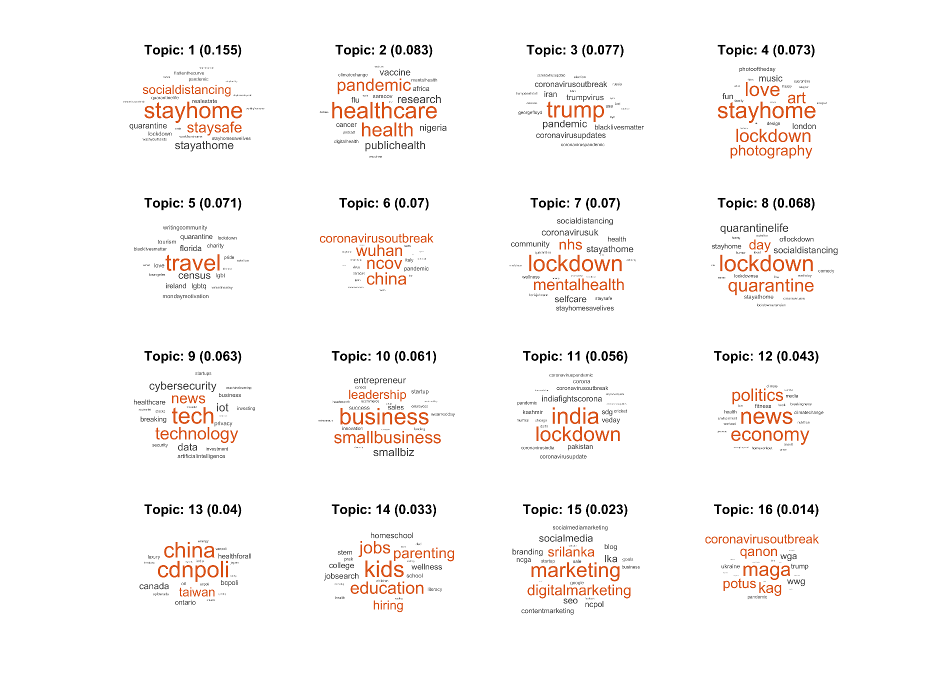
Own Covid-19 Twitter data research

Slide 36
Social Network Analysis
Social network analysis is used on a social network graph to understand its underlying structure, connections, and theoretical properties, as well as to identify the relative importance of different nodes within the network.
Key applications of Social Network Analysis include:
Identifying key influencers in viral marketing campaigns on social media
detecting sub-communities within a larger online community
Predictive modelling (identifying consumers assumed most likely to buy a particular product).
Notes:
Social network analysis (SNA) is the process of investigating social structures through the use of network and graph theories. It characterizes networked structures in terms of nodes (individual actors, people, or things within the network) and the ties or edges (relationships or interactions) that connect them.
SN Analysis = Six Degrees of Separation + Game Theory
Six Degrees of Separation (also referred to as the "Human Web") refers to the idea that, if a person is one step away from each person they know and two steps away from each person who is known by one of the people they know, then everyone is at most six steps away from any other person on Earth.
Game theory attempts to mathematically capture behaviour in strategic situations, in which an individual's success in making choices depends on the choices of others.
The key moment for social network analysis probably came into play immediately after the September 11th terrorist attacks on the United States. It was then that civilian social network analysts began to investigate the 19 hijackers and their associates using publicly-available information released in the media.
One management consultant, Valdis Krebs, scoured newspaper reports to build up a social network of the 19 terrorists that he could begin to analyse. Within weeks, his network began to create a visual and mathematical picture of the links between the terrorists, with each name becoming a "node" in the net.
It soon became obvious to Mr Krebs that one of the key figures was Mohamed Atta, the Egyptian-born ringleader of the group who became a member of alQaeda while studying in Hamburg. Atta's "node" scored highest on all three "centrality metrics" of the social network – measures known as "degrees", "closeness" and "betweenness".
The network also revealed the dense interplay of relationships between a subset of the hijackers who were later known to have formed the terrorist cell that Atta had helped to build up while in Hamburg.

Slide 37
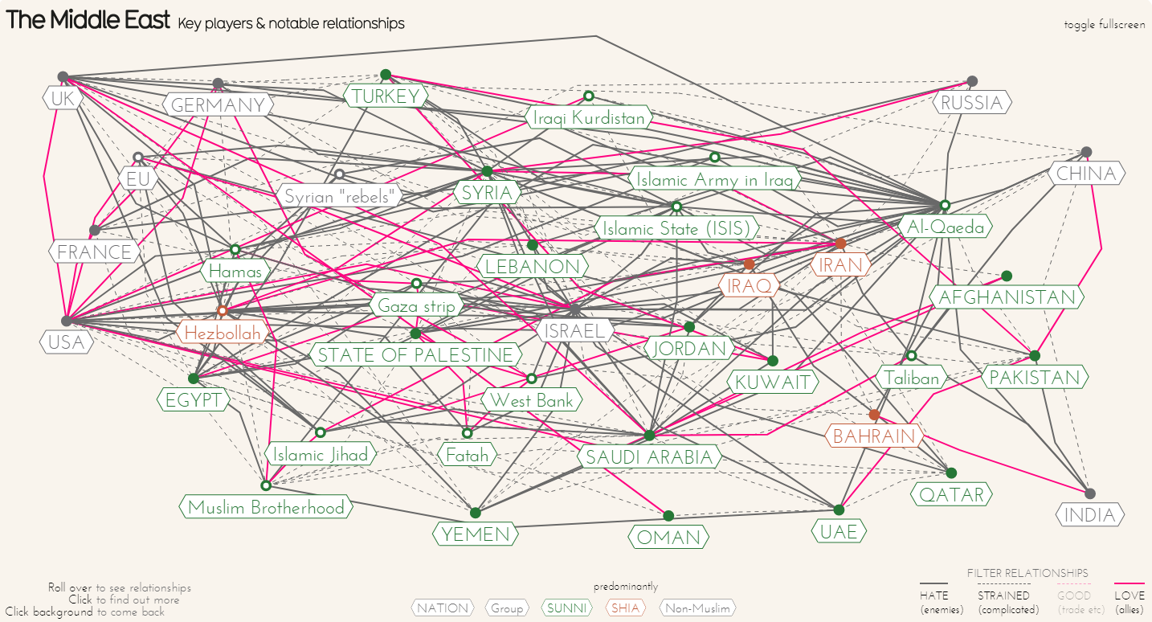
Social Network Analysis Example
http://goo.gl/cbTA2w
Notes:
A forced-network visualisation of key players & notable relationships in the Middle East created by David McCandless & UniversLab.

Slide 38
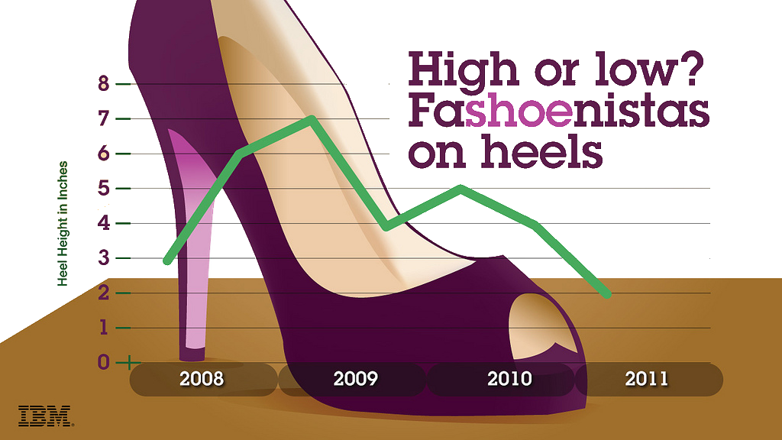
Trend Analysis
Trend analysis is used to predict future outcomes and behaviours based on historical data collected over time.
Trend analysis is based on long-standing statistical methods (such as time-series analysis and regression analysis).
Example: IBM Social Media Analysis
Points to Lower Heels,
Bucking Economic Trend
Notes:
IBM determined the median heel height discussed online by those identified as important shoe mavens in the social media universe. The median height discussed peaked at seven inches in 2009 and declined to two inches in 2011.
“Usually, in an economic downturn, heels go up and stay up – as consumers turn to more flamboyant fashions as a means of fantasy and escape,”. Low-heeled flapper shoes in the 1920s were replaced with high-heel pumps and platforms during the Great Depression. Platforms were again revived during the 1970s oil crisis, reversing the preference for low-heeled sandals in the late 1960s. And the low, thick heels of the 1990s “grunge” period gave way to “Sex and the City”-inspired stilettos following the dot-com bust at the turn of the century.
While heels on women’s shoes are still high – as a visit to any shoe store will confirm -- the IBM analysis points to a change in trend. This data could be used by shoe manufacturers and retailers looking for insight into the kind of shoes to, respectively, manufacture and sell in the coming season.
first, IBM used special analytics software to search billions of social media posts to identify individuals discussing shoes. This initial category contained tens of thousands of posts. Next, the software narrowed the list down to those who are key online influencers in the area of footwear – bloggers, for example. The software relied on special algorithms that rated the popularity of these influencers by zeroing in on the ones who sit in the centre of large social networks – that is, writers of blogs that many other blogs link to and which in turn link to many blogs. These bloggers aren’t traditional “experts” – they don’t work in the footwear industry, for example. But they are passionate footwear enthusiasts with large followings.
Finally, the software analyse the content of the social media sites, looking specifically for discussions of shoe height.

Slide 39
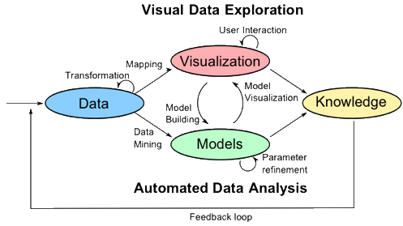
Visual Analytics
Visual analytics is “the science of analytical reasoning facilitated by interactive visual interfaces.”
Thomas and Cook (2006)
Visual analytics can be understood as a collection of techniques that use graphical interfaces to present summarized, heterogeneous information that helps users visually inspect and understand the results of computational processes.
Thomas and Cook (2006)
Notes:
The figure shows an abstract overview of the different stages (represented through ovals) and their transitions (arrows) in the Visual Analytics Process.
In many application scenarios, heterogeneous data sources need to be integrated before visual or automatic analysis methods can be applied. Therefore, the ﬁrst step is often to pre-process and transform the data to derive different representations for further exploration (as indicated by the Transformation arrow in the figure). Other typical preprocessing tasks include data cleaning, normalization, grouping, or integration of heterogeneous data sources.
After the transformation, the analyst may choose between applying visual or automatic analysis methods. If an automated analysis is used ﬁrst, data mining methods are applied to generate models of the original data. Once a model is created the analyst has to evaluate and refine the models, which can best be done by interacting with the data. Visualizations allow the analysts to interact with the automatic methods by modifying parameters or selecting other analysis algorithms. Model visualization can then be used to evaluate the findings of the generated models. Alternating between visual and automatic methods is characteristic for the Visual Analytics process and leads to a continuous refinement and verification of preliminary results. Misleading results in an intermediate step can thus be discovered at an early stage, leading to better results and a higher confidence. If a visual data exploration is performed first, the user has to confirm the generated hypotheses by an automated analysis. User interaction with the visualization is needed to reveal insightful information, for instance by zooming in on different data areas or by considering different visual views on the data. Findings in the visualizations can be used to steer model building in the automatic analysis. In summary, in the Visual Analytics Process knowledge can be gained from visualization, automatic analysis, as well as the preceding interactions between visualizations, models, and the human analysts.

Slide 40
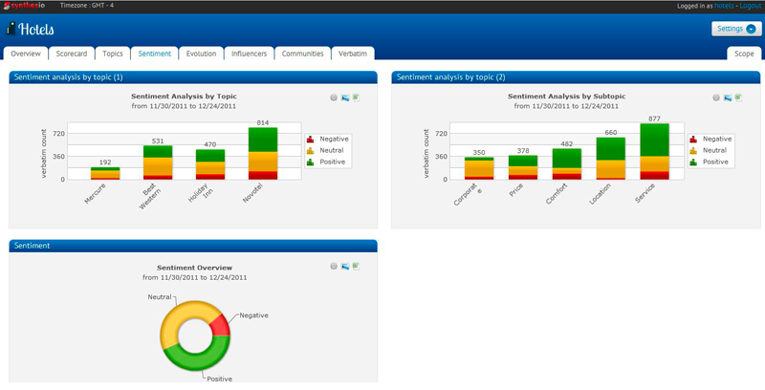
Visual Analytics - Example

Slide 41

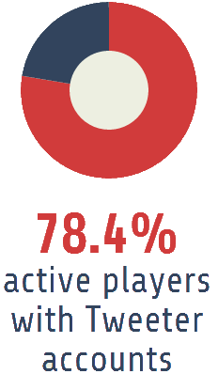

Case I: NBA players’ tweets from Xu et al. (2015)
The purpose of study:
The extent NBA teams can use “unstructured” social media data to further their sports analytics efforts.
Specifically, to show how NBA players’ pre-game emotional state, as captured through their tweets, before a game can help predict on-court performance in the game.
Notes:
THE SPORTS INDUSTRY is big business globally and domestically.
For example, the New York Knicks of the National Basketball Association (NBA) generated $300 million in revenue in 2013. In order for sports organizations to maximize their financial performance, they must win on the court. The operational staffs, including coaches and general managers, must consistently make the right decisions. Sports analytics plays an increasingly important role in such decisions.
Study shows players’ before-game mood, as captured through the sentiment they reveal in their tweets, is positively associated with their on-court performance. NBA teams recognize the importance of tuning player mood before games, taking various approaches to offset negative mood or generate positive mood.
NBA teams cannot follow their players 24 hours a day, especially when off the court. Distributing a questionnaire designed to measure mood is not feasible, as it is time-consuming for professional athletes to complete and cannot be used to test mood before every game. As mentioned earlier, NBA players are active Twitter users, a stream of tweets that represents an enormous, unfiltered opportunity to discern their mood. In this sense, the framework could optimize NBA teams’ ongoing process of adjusting player mood by helping them discern mood more effectively.
The past few years have seen an explosion of tweets by NBA players. NBA players have used this emerging technology to communicate with fans, journalists, peers, friends, and others. They actively voice their opinions, thoughts, and feelings.
353 active players, or approximately 78.4% of the total, had Twitter accounts during the 2012–2013 season, posting a total of 91,659 tweets.
Sentiment analysis, an emerging text-mining technique, can help analyse the tweets of NBA players.
NBA coaches and general managers can use players’ tweets to identify player moods before games and their potential effect on the court.

Slide 42
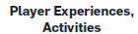
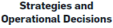







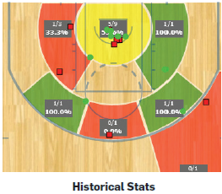
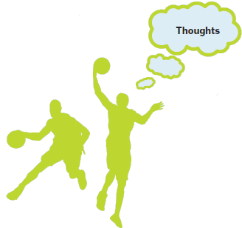
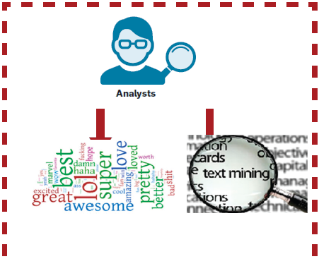
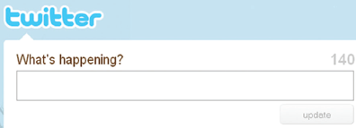

Recommended administrative framework

Slide 43
Case I: Capture
The researchers proposed a framework that uses SMA to process unstructured textual data in sports analytics.
Player game profile
(age, position, salary, home/away game)
Available within NBA teams or through outside parties (BasketballReference.com)
The framework includes three sets of data
Player performance
(field goals, percentage, plus/minus (+/-))
Available on Tweeter or through Web crawlers
Player tweets
Notes:
The proposed framework needs three sets of data:
player/game profile (such as age, position, salary, and home/away game)
Player performance (such as field goals and percentage, plus/minus (+/–)
Player tweets
The first two are available within NBA teams, as well as through outside databases compiled by third parties.
Player tweets are easily viewed on Twitter, and analysts can use Web crawlers to gather data.
The framework:
The framework uses sentiment analysis to discern player mood from player tweets and regression, a type of trend analysis, to identify how that mood is associated with on-court performance. Both techniques are incorporated into existing software, including SAS Sentiment Analysis, SAS Enterprise Miner, and R. These resources free NBA teams from the technical detail of the framework. This low entry barrier to implementation could thus be further motivation for NBA teams to try it.

Slide 44
Case I: Understand
The following pre-processing steps were taken before analysing the tweets:
Filtering out pure retweets
Removing non-English tweets
Misspelling correction through the minimum Hamming distance
Correcting repeating letters (such as “Awwwwful”)
Replacing letters occurring 3 times or more with two consecutive occurrence of the same letter (wwww → ww)
Correcting the tokens as misspelling using minimum Hamming distance
Notes:
In order to represent all tweets accurately, we pre-processed their content by filtering out pure re-tweets and information-oriented tweets containing URL links. We also removed non- English tweets. Given the fact that tweets are replete with non-standard English, we applied a data-cleansing mechanism.

Slide 45
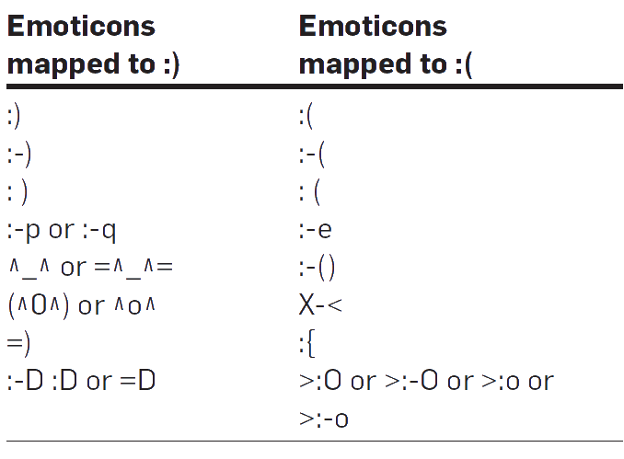
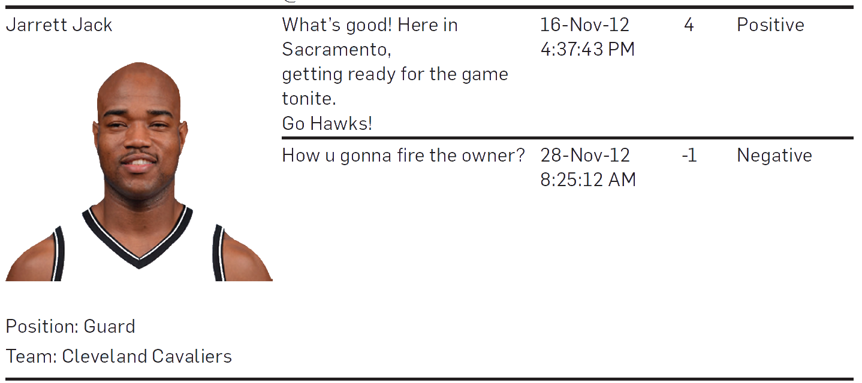
Case I: Understand
AFINN sentiment lexicons were applied to detect polarity of players’ sentiment in tweets.
The computed AFINN score reflects the mood of a player behind the tweet.
Notes:
They applied AFINN (developed by Finn Årup Nielsen of the Technical University of Denmark) sentiment lexicons and an extended hand-assembled list of emoticons to detect the polarity of players’ sentiment in the tweets, or players’ moods behind the tweets.
AFINN rates words between –5 (negative) and +5 (positive), with a larger number representing a more positive sentiment.
They calculated an AFINN score for the tweet by summing the ratings of the positive and negative words matching the lexicon. The computed AFINN score reflects the mood of a player behind the tweet.

Slide 46
Case I: Understand
The following model was developed to test the mood-performance relationship:
P_{i,t} = α + βM_{i,t} + ε_{i,t}
(Baseline model)
where, P_{i,t} is performance of player i for a game at day t
M is player’s mood
The extended model is:
P_{i,t} = α + β₁ M_{i,t} + β₂ P_{i,t–1} + β₃ Salary_{i,t} + β₄ Age_{i,t} + β₅ Age_{i,t}² + β₆ Home_{i,t} + β₇ PosC_{i} + β₈ PosG_{i} + ε_{i,t}
(extended model)
Notes:
To test the mood-performance relationship, they developed a model relating a player’s mood before a game to his performance in the game. They began with a standard baseline model, including mood variable only.
The baseline model might be subject to the “endogeneity” influence common in sports analytics. To limit it, we added control variables that are potential predictors of sports performance.

Slide 47
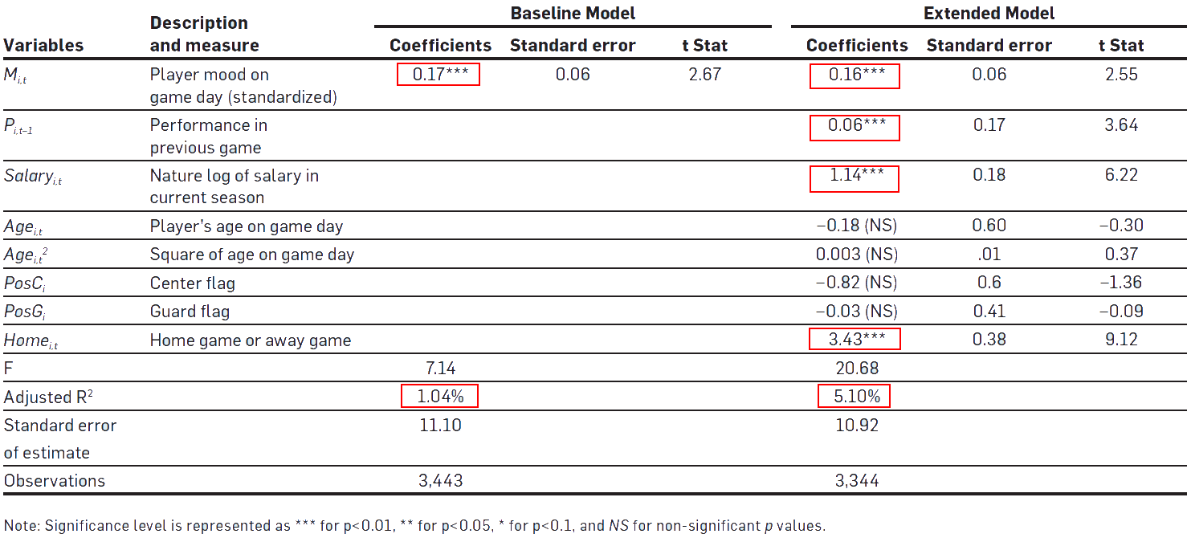
Case I: Present
Notes:
This analysis supports the robustness of the results we found in the baseline model using Twitter as the sole intelligence source. The extended model suggests other applications of the framework for future work and users of sports analytics; for example, an analyst would be able to explore how the mood-performance relationship varies with different player factors and game factors.

Slide 48
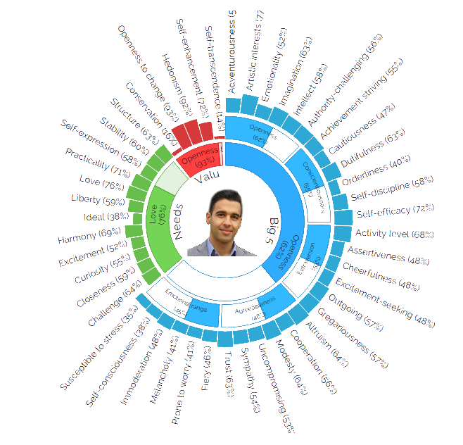


Case II: IBM System U
Insights
Marketing
Who, what, how, and when to target?
Customer service
Agent-Customer matching; real-time assistance
Smarter workforce
Recruitment; talent identification and development; risk identification and mitigation
Personality Portrait
Psycholinguistic Analytics
Big 5 personality traits
(Gosling, 2003)
Fundamental Needs
(Maslow, 1943)
Human Values
(Shwartz, 2006)
Notes:
System U is analytical tool that automatically derive the personality traits from textual data generated by people. These text data could include their tweets, their Facebook posts, or even their daily emails.
So, their work actually is built on top of this line of studies called psycholinguistics, which says that the words that we use every day are powerful reflections of our personality and our social world.
Currently, System U enable us to derive three types of main traits including Big5 personalities, and the fundamental needs, and their basic values and beliefs.
Big5: which is perhaps the most well-known and most used psychological model to measure a person's personality
Fundamental needs: It characterises an individual based on his/her desire
Basic human values: To measure a person’s beliefs and motivators. Example, some people are very much motivated by doing a greater good for the world or other people. We call them as having high level of “transcendence”. For others, they may be motivated by fulfilling their own self or personal success. We call them as having high level of “self-enhancement”.
So if you combine all these, you can gain a better understanding of yourself, what motivates you in life, and what needs you should fulfil – and to use that information to better your life; professionally or personally. Example, professionally you can find a better job, better team. Personally, these information can be used by service/product providers to receive more personalised services and products.
The biggest challenge is to determine what type of words are highly correlated with a type of personality trait. For example, words like ‘within’, ‘include’ are coded as ‘inclusive’ category. And this category of words is highly correlated with somebody who has a personality trait that is very high on agreeableness.
They built a set of psycholinguistic lexicons and used them to examine the use of a particular word, and the frequency of use, and its relationship with a particular personality type.
HOW ACCURATE THESE PREDICTIONS ARE?
A series of validation studies have been conducted, on the quality of analytics. One of these studies tests the concurrent validity of the analytics. So they measured these aspects using to different measures (System U and standardised Questionnaire) from the same sample and tested the correlation between the results. The results so far is very encouraging. They have 80 percent confidence to say that the two-repeated samples are highly correlated in terms of their traits.

Slide 49


IBM System U Demo
IBM Personality Insights Demo
(Click on “view demo” or “see the app”)
http://goo.gl/ueQ6oK
Cambridge instant prediction of psychometric profiles (based on Facebook likes)
http://applymagicsauce.com/

Slide 50
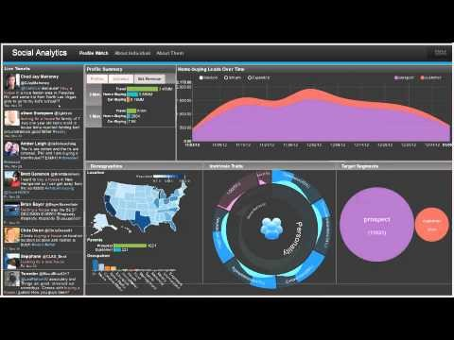
IBM System U and generating business value – an example
https://goo.gl/b6CF4m

Slide 51
Next Class..
 Dynamic capabilities and virtuous cycles of feedback
 We will look into how firms’ renew and reconfigure its resources and capabilities to stay competitive over time.

